Slide 1
Flood Mitigation Investments in the Southern Basin
June 15, 2021

Slide 2
Types of Investment
Floodplain mapping updates (covered previously)
Watershed master planning
Inundation maps
Predictive flood modeling (planning stage)

Slide 3
Goliad County
Notes:
Goliad County was included in the “Holistic Watershed Master Plan for Wilson Karnes, and Goliad Counties”, completed in 2015. In this study, flood risk was identified using a combination of floodplain mapping data and community stakeholder input.
Most of the flood risk was concentrated in the City of Goliad and in Weesache (in the Guadalupe River basin).

Slide 4
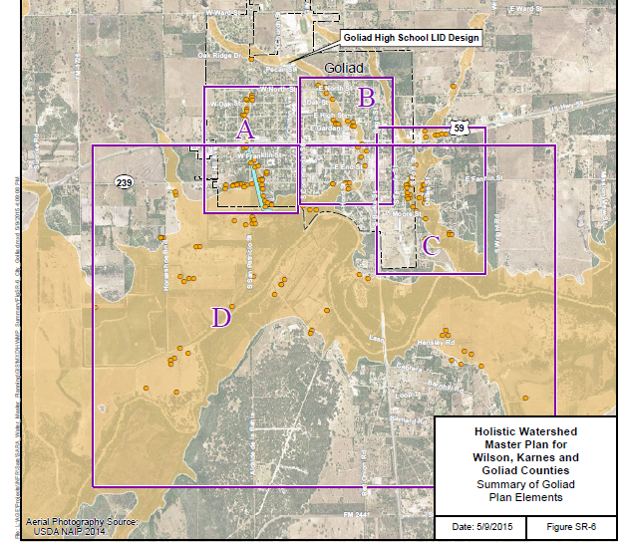
Goliad Recommendations
Property elevation
Vegetated swales
Detention
Notes:
Property elevation produced the greatest benefit-to-cost ratio. This was recommended for all structures at risk for flooding from the San Antonio River (Area D and most of area C).
Vegetated swales were proposed for area A.
Detention was proposed upstream of area B.
Culverts were upgraded in the upper portion of area C, reducing flood risk for the buildings around Hwy 59.

Slide 5
Karnes County
Notes:
Karnes County was also included in the “Holistic Watershed Master Plan for Wilson Karnes, and Goliad Counties”
Much of the building flood risk was adjacent to the San Antonio River with similar recommendations as those in Goliad: property elevation (areas A and B – a subsequent site visit to Falls City revealed that many of the identified structures are substantially elevated).
There is also a concentration of at-risk buildings in Kenedy. The next slide will show more detail there.
The remaining areas (C, D, and F) highlight flood risk at river and creek crossings.
An analysis of emergency routes identified Falls City and Runge as largely isolated from hospitals during floods.

Slide 6
Kenedy Recommendations
Additional study
Raise bridge
Early warning system
Notes:
Area G and Area I were recommended for more detailed modeling and study.
The recommendations to raise the bridge (Hwy 181) and/or create an early warning system apply to Area H.
Karnes County received a Flood Infrastructure Fund grant to further study many of these issues.

Slide 7
Wilson County
Notes:
Wilson County was included in the “Holistic Watershed Master Plan for Wilson Karnes, and Goliad Counties”, but most of the flood risk analysis was performed under individual studies for each community.
In the county-wide study, 9 river/creek crossings were recommended for improvement, and one new road was recommended to improve emergency access routes.

Slide 8
Notes:
The recommendations for each town included a mix of detention, channel improvements, and culvert improvements.

Slide 9
Creek and River Crossings
From “Low Water Crossing Prioritization in the Cibolo Creek Watershed” (Atkins and SA River Authority) Presented at TFMA Fall 2018.
Notes:
A final note on Creek and River Crossings
Major safety concern in rural areas
Along Cibolo Creek, several form boundary between counties
Cibolo Creek watershed master plan used a method for prioritizing the highest risk one using a combination of flood frequency & depth, average daily traffic, and distance to nearest safer crossing.
[image to be added]

Slide 10
Inundation Maps
Notes:
Slide will show example of one along with locations of gauges where maps were developed.
These are pdf maps and paper maps for use when & where internet connectivity is limited.
The show the expected limits of flooding based on the level reported at the USGS gauge and are intended to provide real-time information.

Slide 11
Inundation Maps

Slide 12
Notes:
[This will be a map showing the counties with the river basin highlighted.]
Through our work as a CTP we are aware of several flood mitigation planning efforts in communities outside our jurisdiction, such as the flood early warning system in Bandera and drainage master planning in Boerne, Bulverde, and Cibolo, just to name a few.

Slide 13
Questions?

